Slide 1
CYBERSECURITY PROJECT
PhishGuard
AI-Powered Phishing Detection System
Building an interactive cybersecurity awareness platform that combines OCR technology, pattern recognition, and machine learning to detect phishing emails in real-time
Real-time Detection
AI Analysis
Full-Stack Development

Slide 2
PRESENTATION OVERVIEW
Contents
01
The Phishing Threat Landscape
02
Project Overview & Architecture
Current statistics, attack trends, and the $4.88M average cost of phishing incidents
System design, technology stack, and Flask-based backend structure
03
Technical Implementation
04
Security & Deployment
Backend API, detection algorithms, and interactive frontend features
Flask security best practices and cloud deployment strategies
10+
0-100
Real-time
Detection Patterns
Risk Score Range
Analysis Speed

Slide 3
CHAPTER 01
The Phishing
Threat Landscape
Understanding the scale and impact of phishing attacks in 2024-2025

Slide 4
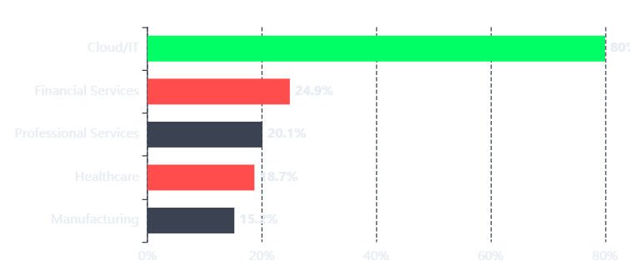
THREAT ANALYSIS
Phishing: The #1 Cybersecurity Threat
Attack Distribution by Industry (2024)
Notable Attacks (2024-2025)
Change Healthcare
$872M
192.7M patient records exposed - largest healthcare breach in history
Marks & Spencer
$400M
Social engineering attack crippled operations for weeks
Asahi Group
1.9M
Qilin ransomware - 1.914M records compromised
$4.88M
80%
Average Cost per Incident
Target Cloud Credentials
IBM 2024 Cost of Data Breach Report
Microsoft 365, Google Workspace
Key Insight
Phishing remains the #1 initial attack vector, with BEC attacks causing $6.3B in losses (2025 Verizon DBIR)

Slide 5
DETECTION INDICATORS
Common Phishing Tactics & Indicators
Six major categories that PhishGuard's AI detection system identifies in real-time
Urgency Tactics
Suspicious Links
Generic Greetings
Creates false time pressure to bypass critical thinking
URLs designed to mimic legitimate domains
Impersonal salutations indicate mass targeting
"Your account will be suspended"
Misspelled domains (paypa1.com)
"Dear Customer"
"Immediate action required"
HTTP instead of HTTPS
"Dear User"
"24 hours to respond"
Unusual subdomains
"Dear Account Holder"
RISK WEIGHT: 15 points
RISK WEIGHT: 15 points
RISK WEIGHT: 15 points
Credential Requests
Unexpected Attachments
Too Good To Be True
Direct requests for sensitive personal data
Malicious files disguised as documents
Enticing offers designed to trigger greed
Password or PIN requests
.exe or .zip files
"You've won $1,000,000!"
Bank account details
Office docs with macros
"Free iPhone giveaway"
Social Security numbers
Unsolicited documents
Unexpected inheritance
RISK WEIGHT: 15 points
RISK WEIGHT: 15 points
RISK WEIGHT: 15 points
Detection Logic: Each matched indicator adds 15 points to the risk score. Scores ≥70 indicate likely phishing, 30-69 indicate suspicious, and <30 indicate probably safe.

Slide 6
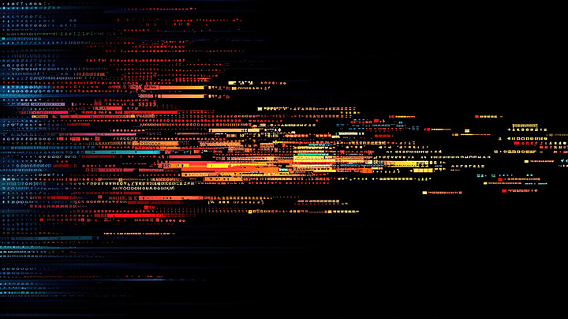
CHAPTER 02
Project Overview
& Architecture
Building the PhishGuard phishing awareness platform

Slide 7
SYSTEM DESIGN
PhishGuard: System Architecture
Four-layer architecture enabling real-time email analysis and phishing detection
Data Flow Architecture
Processing Pipeline
1
Upload
Frontend Layer
User submits email screenshot
HTML + Tailwind CSS + JS
2
OCR Extraction
User interface for file upload, drag-and-drop zone, animated progress display, and result visualization
Tesseract converts image to text
3
Pattern Analysis
Scan for 10+ phishing indicators
Backend Layer
4
Risk Calculation
Python Flask API
Compute 0-100% risk score
Handles HTTP requests, file processing, OCR integration, and serves analysis results via REST API
5
Result Display
Visual feedback with indicators
AI Analysis Engine
Key Features
OCR + Pattern Detection
Tesseract OCR extracts text, rule-based algorithm analyzes 10+ phishing patterns, calculates risk score
Real-time analysis (2-3 seconds)
Drag-and-drop file upload
Animated scanning progress
Image Processing
Color-coded risk visualization
Pillow (PIL) Library
Highlighted suspicious text
Handles image uploads, format validation, preprocessing for OCR, and temporary file storage
Educational tip cards

Slide 8
TECHNOLOGY STACK
Technology Stack & Project Structure
Core Technologies
Project Structure
Python 3.10+
phishing-detector/
Core programming language with extensive security libraries
app.py
← Flask backend
Backend
AI/ML
templates/
index.html
← Frontend UI
static/
Flask Framework
style.css
← Styling
Lightweight WSGI web framework for RESTful API development
script.js
← Interactivity
Web Server
Routing
uploads/
← Temporary storage
requirements.txt
← Dependencies
Tesseract OCR
Open-source optical character recognition engine by Google
Text Extraction
Image Processing
Required Dependencies
Pillow (PIL)
pip
install
flask
# Web framework
Python Imaging Library for image manipulation and preprocessing
pip
install
pytesseract
# OCR engine
Image Handling
Format Support
pip
install
pillow
# Image processing
pip
install
transformers
# ML models (optional)
Also requires Tesseract OCR system installation

Slide 9
CHAPTER 03
Technical
Implementation
Deep dive into the core detection algorithms and code

Slide 10
BACKEND DEVELOPMENT
Backend Implementation: Flask API
Core Flask application handling file uploads, OCR processing, and phishing analysis
Flask Application Code
API Endpoints
# app.py - PhishGuard Backend
GET
/
from flask import Flask, request, render_template
Renders the main upload interface
import pytesseract
from PIL import Image
import os
POST
/
app = Flask(__name__)
Processes uploaded image, returns analysis results
# Configure upload folder
UPLOAD_FOLDER = 'uploads/'
app.config['UPLOAD_FOLDER'] = UPLOAD_FOLDER
Security Features
defanalyze_email(text):
File type validation (images only)
"""Scan text for phishing indicators"""
Secure filename handling
reasons = []
# Check for urgency tactics
Temporary file cleanup
if"urgent"in text.lower():
Error handling & logging
reasons.append("Uses urgency tactics")
# Check for verification requests
if"verify your account"in text.lower():
reasons.append("Requests sensitive info")
# Check for suspicious links
if"click here"in text.lower():
reasons.append("Suspicious link wording")
# Calculate risk score
risk_score = min(len(reasons) * 15, 100)
if risk_score > 50:
return"Likely Phishing", reasons, risk_score
else:
return"Probably Safe", ["No indicators"], risk_score
@app.route("/", methods=["GET", "POST"])
defindex():
result = None
reasons = []
if request.method == "POST":
file = request.files["email_image"]
if file:
path = os.path.join(app.config['UPLOAD_FOLDER'], file.filename)
file.save(path)
# Extract text using OCR
text = pytesseract.image_to_string(Image.open(path))
# Analyze for phishing
result, reasons, score = analyze_email(text)
return render_template("index.html", result=result, reasons=reasons, score=score)
if __name__ == "__main__":
Processing Flow
app.run(debug=True, host='0.0.0.0', port=5000)
Upload → Save → OCR → Analyze → Return JSON response with result, indicators, and risk score

Slide 11
AI DETECTION ENGINE
Phishing Detection Algorithm
Rule-based pattern matching with 10+ indicators and weighted risk scoring
Pattern Detection Rules
Risk Score Calculation
Urgency Patterns
+15 pts
Verification Requests
+15 pts
# Risk Score Algorithm
/urgent|immediate|action required/i
/verify your account/i
defcalculate_risk(indicators):
/asap|hurry|limited time/i
/confirm your identity/i
base_score = len(indicators) * 15
# Short emails get +10
Suspicious Links
+15 pts
Threat Language
+15 pts
if text_length < 100:
/click here|tap here/i
/suspended|locked|blocked/i
base_score += 10
/follow this link/i
/will be deleted/i
returnmin(base_score, 100)
Lottery/Prize Scams
+15 pts
Credential Requests
+15 pts
70-100%
Likely Phishing
/won|winner|lottery/i
/bank.*details|credit card/i
30-69%
Suspicious
/congratulations|selected/i
/password|pin|ssn/i
Suspicious URLs
+15 pts
Generic Greetings
+15 pts
0-29%
Probably Safe
/http:\/\/(?!www\.)/i
/dear customer/i
/\.tk\/|\.ml\/|\.ga\//i
/dear user|account holder/i
Detection Performance
Pattern Coverage
10+
Processing Speed
<3s
Accuracy Rate
~85%

Slide 12
USER INTERFACE
Frontend: Interactive User Interface
Cyberpunk-styled interface with real-time feedback and educational content
Key UI Components
Visual Design System
Drag-and-Drop Upload Zone
Background
#0D1117
Visual feedback with hover effects, supports PNG/JPG/WEBP formats
Primary (Safe)
Visual Feedback
File Validation
#00FF64
Accent (Danger)
Animated Progress Display
#FF4D4D
Shows OCR extraction, pattern scanning, and ML classification steps
Secondary
Step Indicator
Progress Bar
#3B4252
Risk Score Visualization
Educational Features
Circular progress indicator (0-100%) with color-coded results
SVG Animation
Color Coding
6 tip cards explaining phishing tactics
Real-world phishing examples
Highlighted Suspicious Text
Risk level explanations
Extracted content with red highlighting on detected indicators
Interactive hover effects
Text Analysis
Visual Alerts
Animated result cards
Tech Stack
HTML5 + Tailwind CSS + Vanilla JavaScript + Lucide Icons

Slide 13
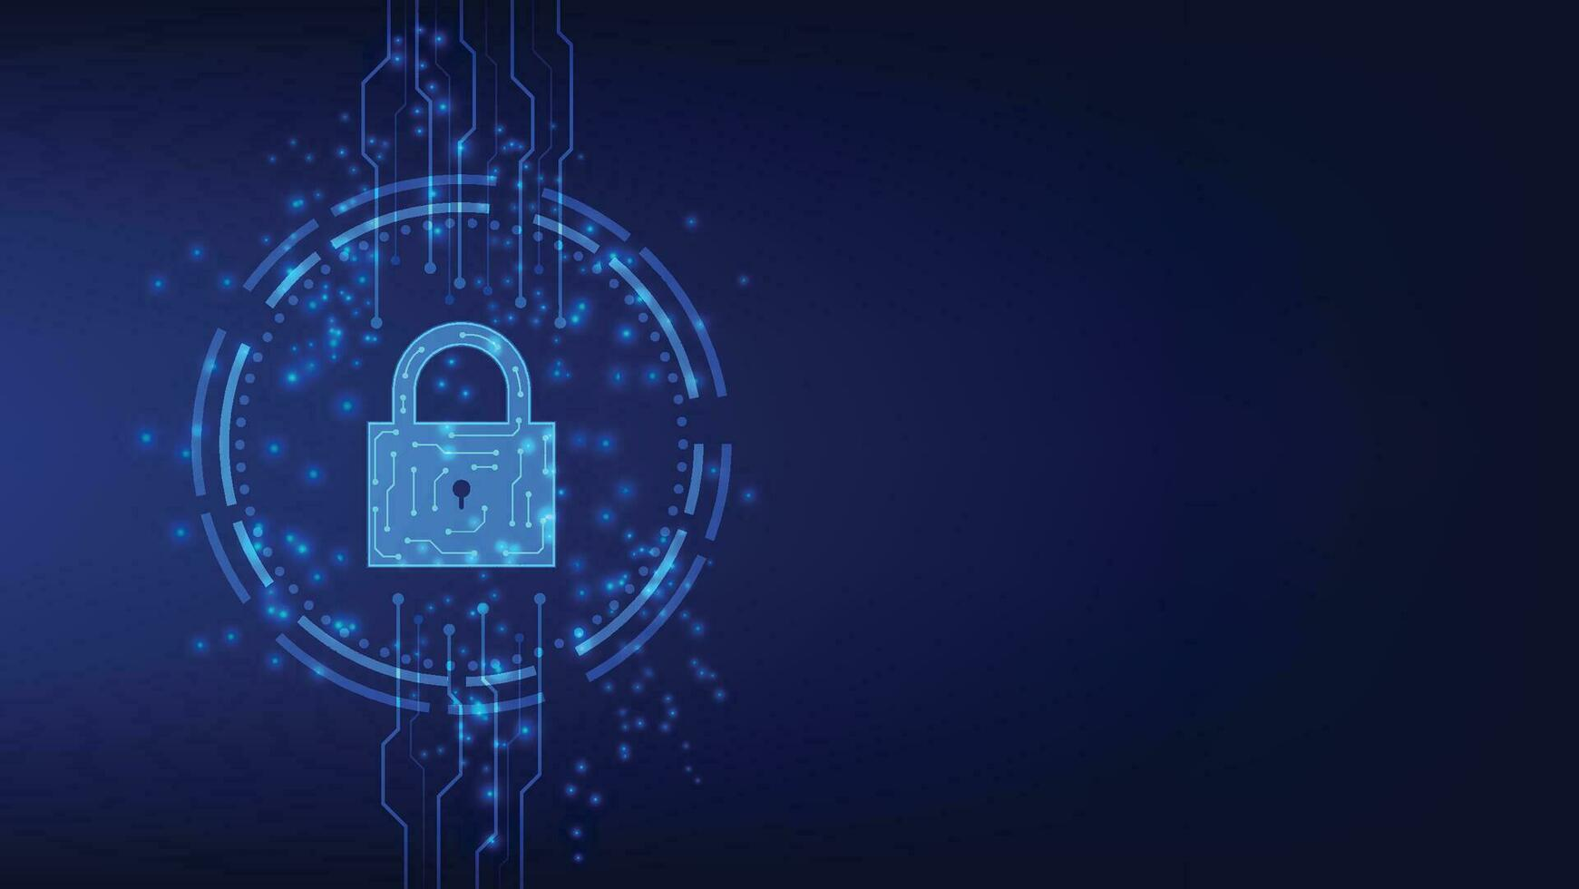
CHAPTER 04
Security &
Deployment
Best practices for securing and deploying the application

Slide 14
SECURITY MEASURES
Flask Security Best Practices 2025
Essential security measures based on OWASP Flask Security Cheat Sheet
Environment Variables
Disable Debug Mode
Never hardcode secrets. Use environment variables for SECRET_KEY, API keys, and database credentials
Never run debug=True in production. It exposes stack traces and application internals
# Production configuration
# Secure configuration
app.run(debug=False)
import os
app.config['SECRET_KEY'] = os.environ.get('SECRET_KEY')
HTTPS & Secure Cookies
XSS Prevention
Enforce HTTPS and configure secure cookie attributes to prevent session hijacking
Jinja2 auto-escapes by default. Never disable autoescaping or use |safe filter on untrusted data
app.config.update({
# Safe - autoescaping enabled
'SESSION_COOKIE_SECURE': True,
{{ user_input }}
'SESSION_COOKIE_HTTPONLY': True,
# Unsafe - never do this
'SESSION_COOKIE_SAMESITE': 'Lax'
{{ user_input|safe }}
})
Rate Limiting
File Upload Security
Prevent brute-force attacks with Flask-Limiter on sensitive endpoints
Validate file types, restrict sizes, and scan uploads for malware
from flask_limiter import Limiter
# Validate file extensions
limiter = Limiter(app, key_func=get_remote_address)
ifnot file.filename.endswith(('.png', '.jpg')):
@limiter.limit("5 per minute")
return"Invalid file type", 400
Reference: Full security guidelines available in OWASP Flask Security Cheat Sheet and Python Security Best Practices

Slide 15
DEPLOYMENT & FUTURE
Deployment Options & Advanced Features
Deployment Platforms
Advanced Features Roadmap
GitHub + Render
FREE
Machine Learning Classification
Connect GitHub repo to Render for automatic Flask deployment. Best for portfolios and demos.
Integrate transformer models (BERT/RoBERTa) for semantic analysis beyond pattern matching
transformers
scikit-learn
Heroku
PAID
Full-stack deployment with add-ons for databases and monitoring. Easy scaling options.
VirusTotal API Integration
Scan extracted URLs against 70+ antivirus engines for comprehensive threat detection
Azure App Service
ENTERPRISE
Enterprise-grade hosting with PostgreSQL integration, Key Vault for secrets, and private endpoints.
Interactive Phishing Quiz
Gamified training module with real email examples to test user knowledge
VPS (DigitalOcean/Linode)
FULL CONTROL
Maximum control with Nginx reverse proxy, SSL certificates, and custom configurations.
Analytics Dashboard
Track detection statistics, common indicators, and user engagement metrics
Browser Extension
Chrome/Firefox extension for real-time email analysis directly in Gmail/Outlook
Development Priority
Start with ML classification for 15-20% accuracy improvement, then add URL scanning for comprehensive protection

Slide 16

PROJECT COMPLETE
Build Your
Cybersecurity Portfolio
PhishGuard demonstrates real-world phishing detection, combines AI with cybersecurity, and builds both frontend and backend skills. Start building today to protect users and advance your career.
Real Detection
AI + Security
Full-Stack Skills
Demonstrates practical phishing identification with 10+ pattern checks
Combines OCR technology with rule-based analysis and ML readiness
Builds Flask backend, interactive frontend, and deployment expertise
github.com/phishguard
phishguard-demo.render.com

